Slide 1
Measurement
Rule up 3 column notes!
Topic: Area of Composite Shapes 1
EQ: How do we find the area of composite shapes?
Mrs Stretch
Year

Slide 2
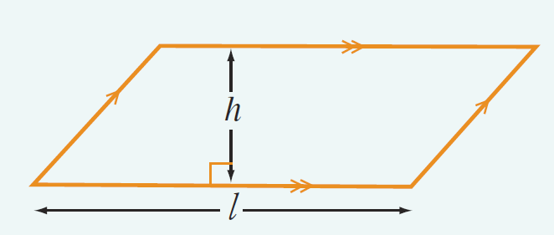
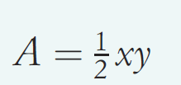
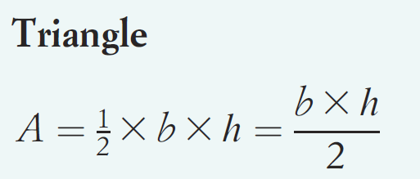
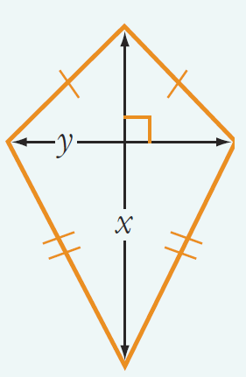
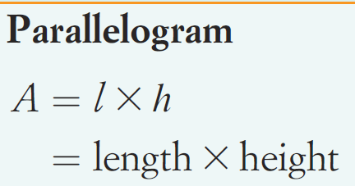
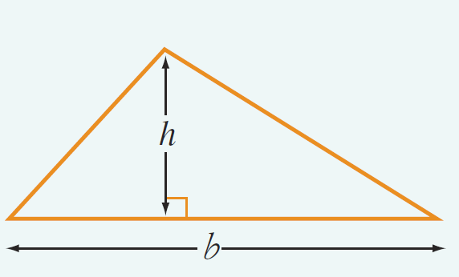
Recap
Parallelogram
Kite
Triangle

Slide 3
24
7
30
Area of Composite Shapes
Date
EQ – How do we find the area of composite shapes?
Question
Examples
Steps
What are composite shapes?
Composite shape: a 2D shape made up of many shapes
To find the area of compound shapes, split them up into their composite shapes.
Find the area of each shape, then add them together
How do we find the area of composite shapes?

Slide 4


Slide 5
Practice
8cm
Area A = 8 x 5
= 40cm²
A
5cm
Area B = 11 x 2
= 22cm²
B
11cm
Total Area = 40 + 22
= 62cm²
2cm

Slide 6
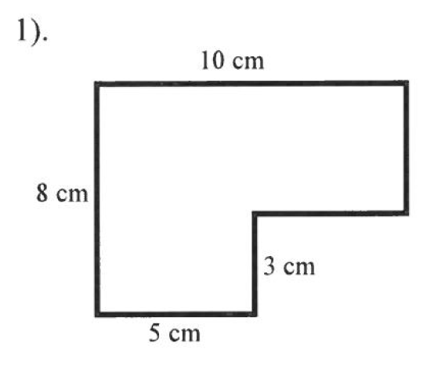
Practice

